Slide 1
Financial Accounting Fundamentals Course culminating Activity
BY: Kelly Wang, Jamie Abraham, Hannah Kim.

Slide 2



Companies
Rogers Communication
Bell Canada
Shaw Communications

Slide 3
ROGERS COMMUNICATION
public Canadian communications and media company
Wireless communications, cable television, telephone, and internet connectivity with significant additional telecommunications, mass media assets.
Founded 1925
One of Canada's most valuable company

Slide 4
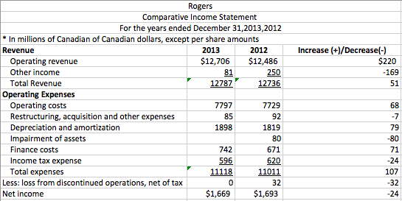
Comparative income statement

Slide 5
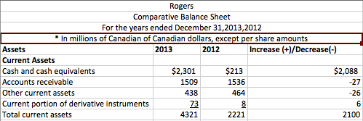
Comparative balance sheet

Slide 6
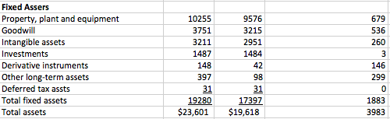
Comparative balance sheet CONT.

Slide 7
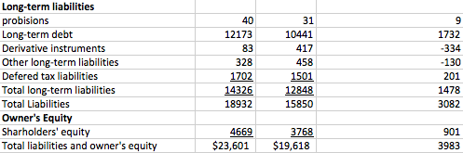
Comparative balance sheet CONT.

Slide 8
Ratios
Working Capital:
2013: 4321-4606=- $285
2012: 2221-3002=- $781
Current Ratio:
2013:4321/4606=0.9:1
2012: 2221/3001=0.7:1
Quick ratio:
2013: (2,301+1590+438)/4606= 0.9:1
2012: (213+1536+464)/3002= 0.7:1

Slide 9
Ratios cont.
Equity ratio:
2013: (4669/23601) x100%=19.7%
2012: (3768/19618) x100%= 19.2%

Slide 10
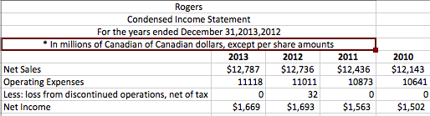
Condensed income statement

Slide 11
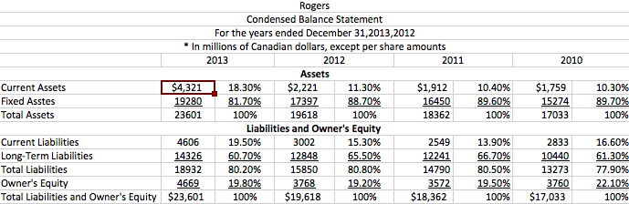
Condensed balance sheet

Slide 12
improve current status
implement their productivity improvement initiative to increase the revenue
focus on fewer, more impactful projects others than small projects that do not bring much change to the company’s profit.
manage their expenses carefully in order for them to have a greater net income

Slide 13
Shaw Communications Inc.
Canadian Telecommunications company that provides telephone, Internet and television services as well as mass media related services.
Shaw provides services mostly in British Columbia and Alberta, with smaller systems in Saskatchewan, Manitoba, and North-western Ontario.
was founded as Capital Cable Television Company, Ltd. in Edmonton, Alberta, in 1966

Slide 14
Comparative income statement
Gross profit decreased by $10, 000, 000
Sales increased by $23, 000, 000
Cost of Sales increased by $33, 000, 000
Operating Expenses decreased by $32, 000, 000
Net Income increased by $22, 000, 000

Slide 15
Comparative balance sheet
Total Assets decreased by $3189, 000, 000
Current Assets decreased by $61, 000, 000
Fixed Assets decreased by $2, 000, 000
Total Liabilities decreased by $93, 000, 000
Current Liabilities decreased by $533, 000, 000
Long- Term Liabilities increased by S440, 000, 000
Owner’s Equity increased by $413, 000, 000
Total Liabilities and Owner’s Equity increased by $320, 000, 000

Slide 16
Condensed balance sheet
Current Assets decreased by 0.7%
Fixed Assets decreased by 1.7%
Total Liabilities decreased by 2.3%
Owner’s Equity increased by 2.3%

Slide 17
Condensed income statement
Net Sales has increased significantly
Cost of Sales increased by 1.9%
Net Income increased by 1.4%

Slide 18
Ratio analysis
Working Capital
2014: -$177
2013: -$589
Current Ratio
2014: 0.9 : 1
2013: 0.7 : 1
Quick Ratio
2014: 0.7 : 1
2013: 0.3 : 1
Equity Ratio
2014: 36.6%
2013: 34.3%

Slide 19
Improve current status
Reduce expenses
Sell assets to pay off outstanding debt
Expand company to see services to more provinces

Slide 20
Bell canada
Canada’s largest communications company, providing a comprehensive broadband communication services to residential and business customers in Canada.
The services include high-speed Fibe internet, TV, Home Phone local and long distance services as well as IP-broadband services and information and communications technology services.
Canada’s # 1 television network, and the country’s most watched specialty channels

Slide 21
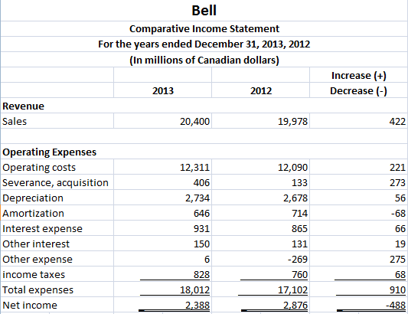
Comparative income statement

Slide 22
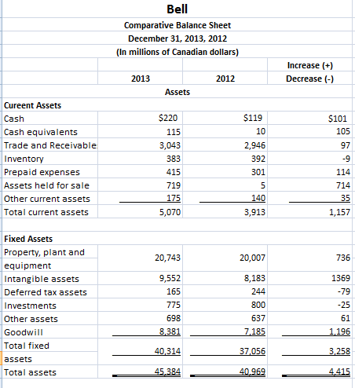
Comparative balance sheet
Current Asset is increased by $ 1157 000 000
Fixed Asset is increased by $ 3258 000 000
Total Asset is increased by $ 4415 000 000
Current Liability is increased by $ 1144 000 000
Long-Term Liability is increased by $ 1746 000 000
Total Liability is increased by $ 2890 000 000
Owner’s equity is increased by $ 1525 000 000
Total Liability and owner’s equity is increased by $ 4415 000 000

Slide 23
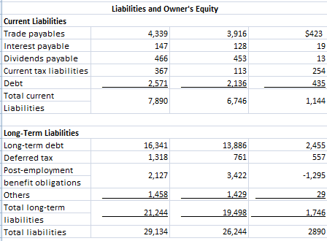
Comparative balance sheet

Slide 24
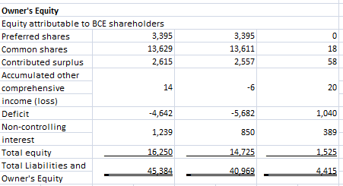
Comparative balance sheet

Slide 25
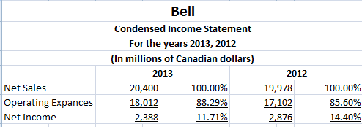
Condensed income statement
A small increase in Net Sale
Operating expanse has increased
Net income has decreased

Slide 26
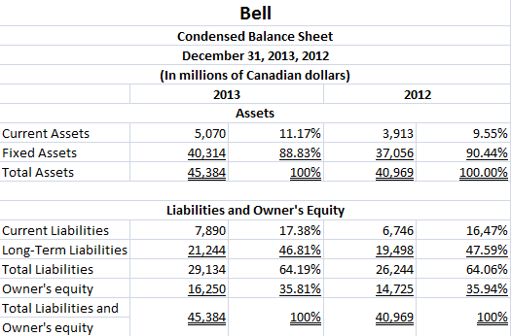
Condensed balance sheet
Current Asset increased by 1.6%
Fixed Asset dereased by 1.6%
Total Liabilities increased by 0.1%
Owner’s Equity decreased by 0.1%

Slide 27
Ratio analysis (in millions of Canadian $)
Working Capital
2013: $5070 - $7890 = - $2820
2012: $3913 - $6746 = - $2833
Current Ratio
2013: $5070/$7890 = 0.6:1
2012: $3913/$6746 = 0.6:1
Quick Ratio
2013: ($335 + $3043 + $1102)/$7890 = 0.6:1
2012: ($129 + $2946 + $397)/$6746 = 0.5:1
Equity Ratio
2013: $16250/$45384 x 100% = 35.8%
2012: $14725/$40969 x 100% = 35.9%

Slide 28
Improve current status
Increase net income
Raise their sales revenues
Manage expenses

Slide 29
We believe shaw communication progressed best over all because:
Increased in net income of $22 000 000. However, Rogers and Bell decreased its net income
Least increase in expenses
Has the highest working capital
Highest current assets
Lowest liabilities

